Slide 1
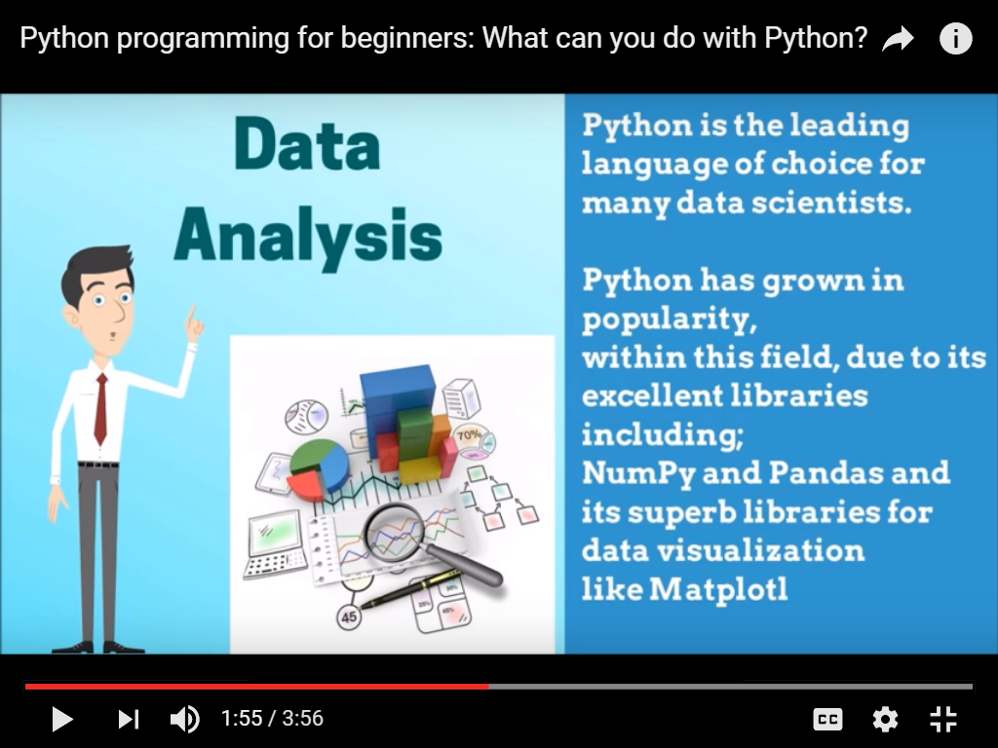
PYTHON AND DATA ANALYSIS

Slide 2
INSTRUCTIONS TO ATTENDEES
Keep the microphone and camera off throughout the session
Use hand raise option to acknowledge the host
Post your answers in the chat box
A mentor will be allocated to clarify all your doubts which were posted in Q&A area.
Any specific doubt related to content/problem kindly ask in the Q&A tab.

Slide 3


AGENDA
OOPS
OOPS CONCEPTS

Slide 4
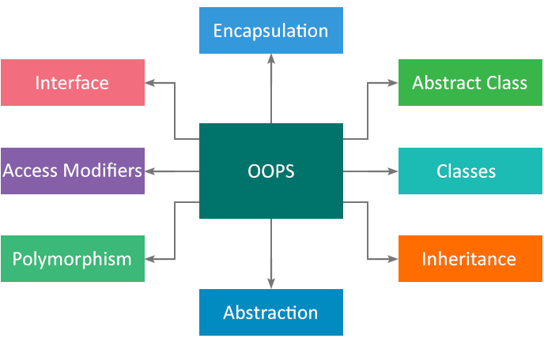
OOPS – OBJECT ORIENTED PARADIGMS

Slide 5
BASIC TERMINOLOGIES OF OOPS
Class
Objects
Methods
Constructors

Slide 6
CLASS
The primary purpose of class is to store data and information.
The members of class defines the class.
Class cannot be seen to real world but an object can be seen.
A class is basically an object constructor or a blueprint for an object.
Class is an abstract as well user defined data type.

Slide 7
CREATING AN INSTANCE OF THE CLASS
A class needs to be instantiated if we want to use the class attributes in another class or method.
A class can be instantiated by calling the class using the class name.

Slide 8
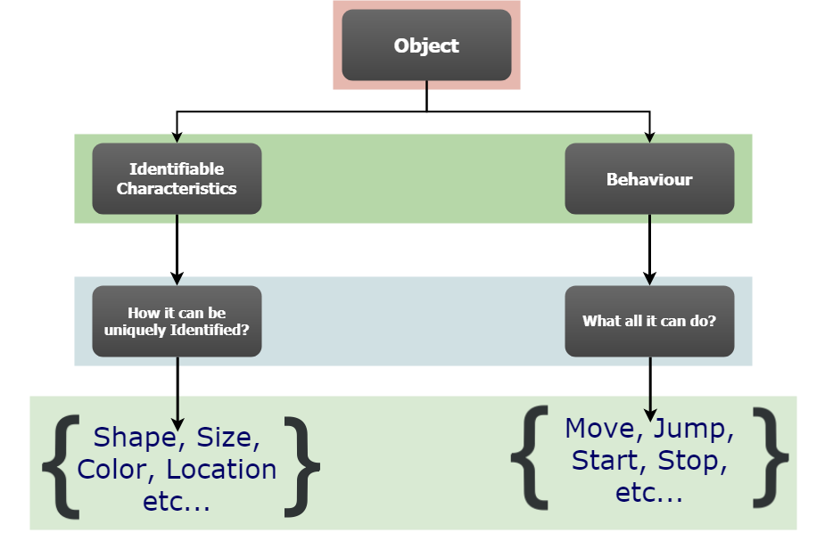
OBJECTS

Slide 9
OBJECTS
Objects are an encapsulation of variables and functions into a single entity.
Objects get their variables and functions from classes.
The implementation of class is an object
The class is not visible to the outside world but object does

Slide 10
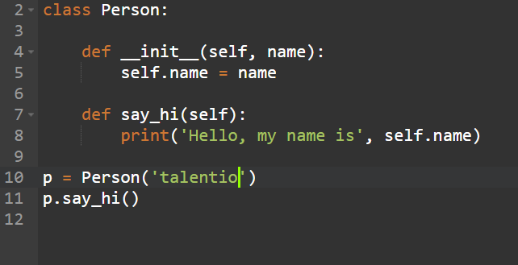
OBJECT CREATION using __init__ method
The __init__ method is similar to constructors in C++ and Java. It is run as soon as an object of a class is instantiated. The method is useful to do any initialization you want to do with your object.
CONSTRUCTOR
METHOD
OBJECT
ACCESSING METHOD
USING OBJECT

Slide 11
WHAT IS THE OUTPUT
The thing required to create an object
a . constructor
b . class
c . built-in functions
d . user defined functions
a

Slide 12
WHAT IS THE OUTPUT
class test:
def __init__(self,a="Hello World"):
self.a=a
def display(self):
print(self.a)
obj=test()
obj.display()
a) The program has an error because constructor can’t have default arguments b) Nothing is displayed c) “Hello World” is displayed d) The program has an error display function doesn’t have parameters
c

Slide 13
WHAT IS THE OUTPUT
class A:
def __init__(self,b):
self.b=b
def display(self):
print(self.b)
obj=A("Hello")
del obj
a) True b) False
a

Slide 14
OOPS CONEPTS
Inheritance
Polymorphism
Data Encapsulation
Data Abstraction
Exception Handling

Slide 15
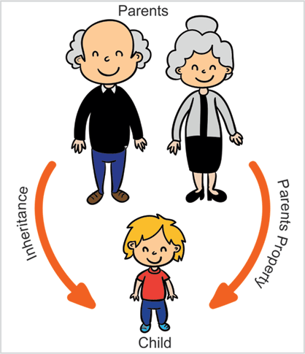
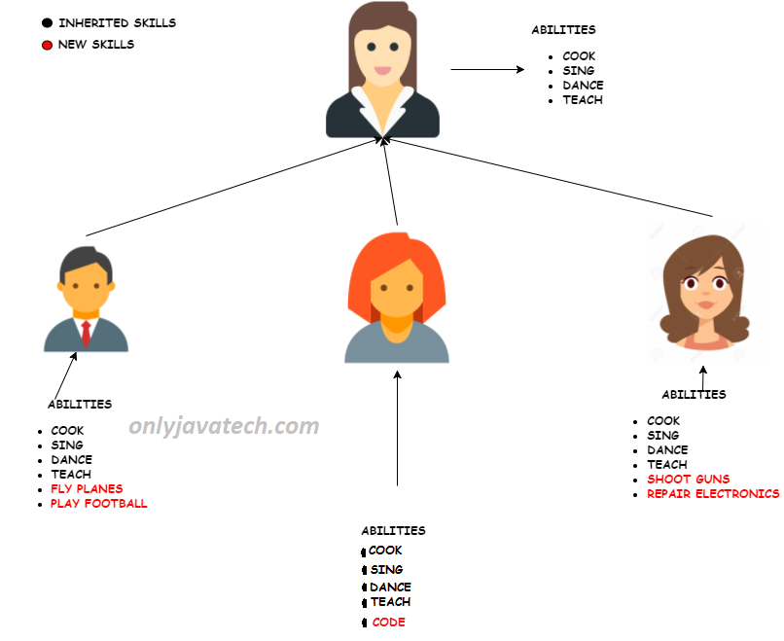
INHERITANCE

Slide 16
INHERITANCE
Inheritance allows us to define a class that inherits all the methods and properties from another class.
Parent class is the class being inherited from, also called base class.
Child class is the class that inherits from another class, also called derived class.
Syntax of Inheritance
class DerivedClassName(BaseClassName): Statement-1 Statement-1 .... .... .... Statement-n

Slide 17
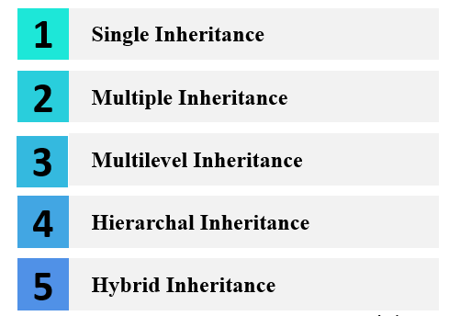
TYPES OF INHERITANCE

Slide 18
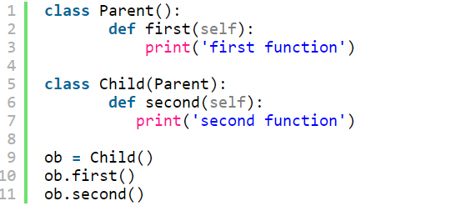
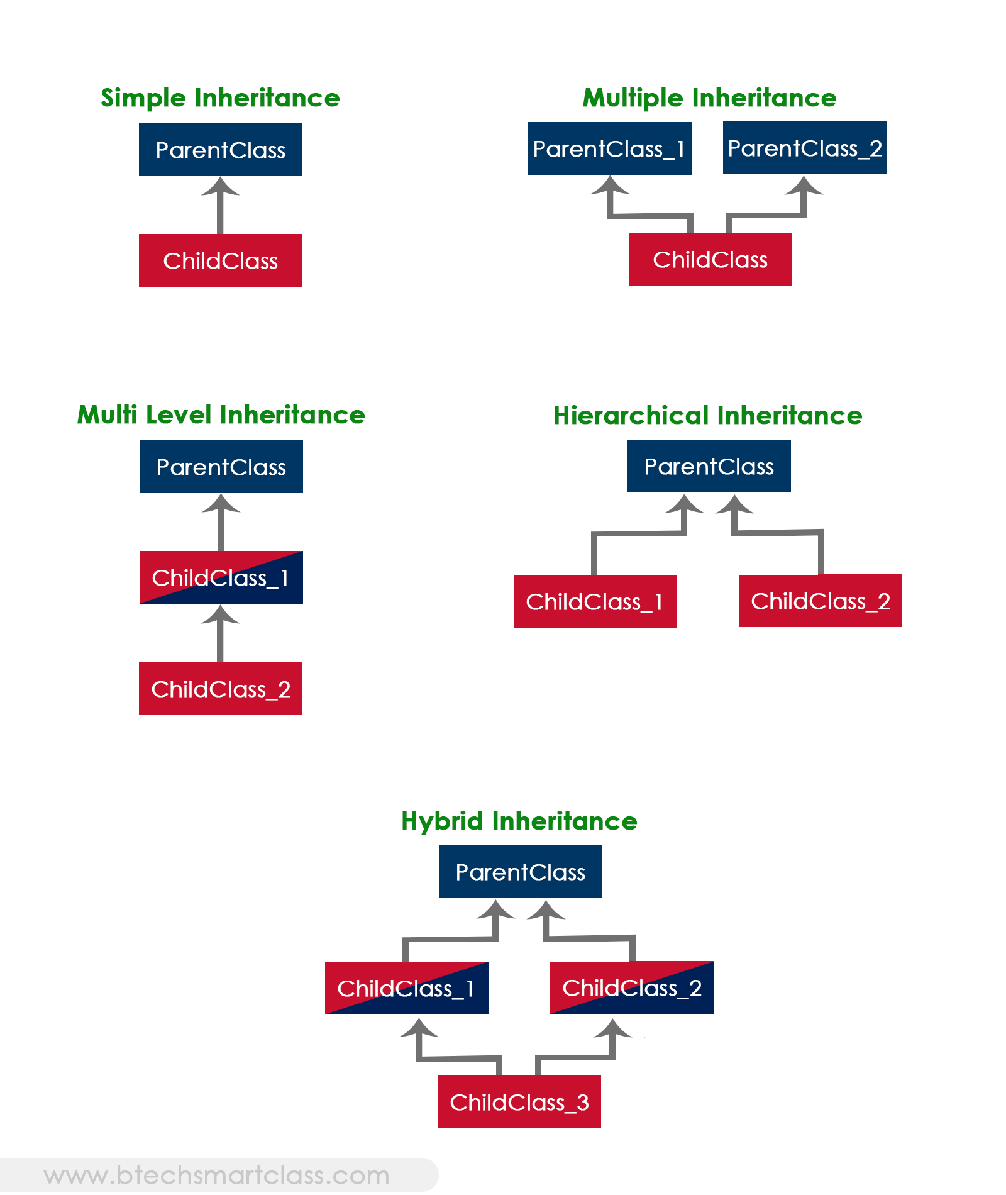
SINGLE INHERITANCE
When a child class inherits from one parent class, it is single inheritance.

Slide 19
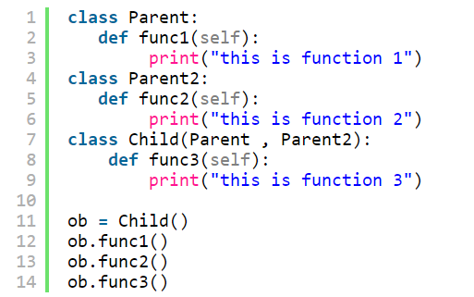
MULTIPLE INHERITANCE
When a child class inherits from more than one parent class, it is multiple inheritance.

Slide 20
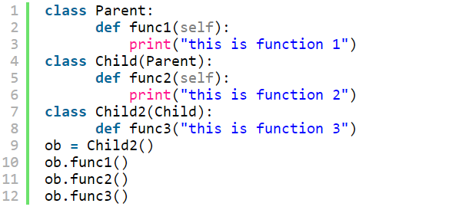
MULTI LEVEL INHERITANCE
When a child class inherits from other child class , it is multi-level inheritance.

Slide 21
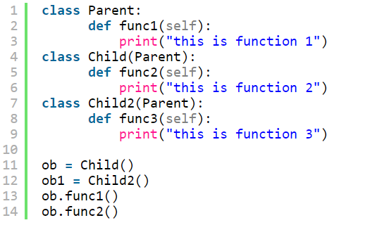
HIERARCHICAL INHERITANCE
Hierarchical inheritance involves multiple inheritance from the same base or parent class.

Slide 22
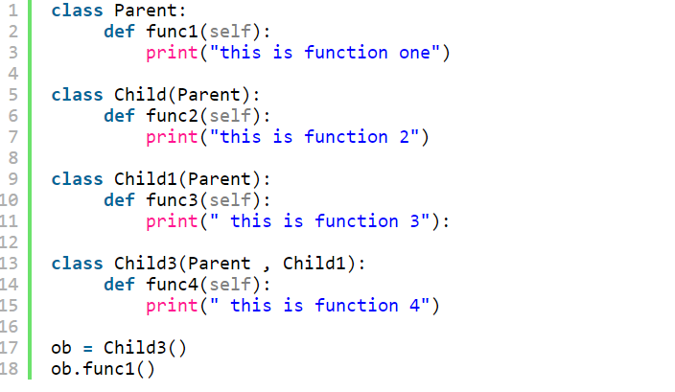
HYBRID INHERITANCE
Hybrid inheritance involves multiple inheritance taking place in single program.

Slide 23
WHAT IS THE OUTPUT
Which of the following statements is wrong about inheritance?
a) Protected members of a class can be inherited b) The inheriting class is called a subclass c) Private members of a class can be inherited and accessed d) Inheritance is one of the features of OOP
c

Slide 24
WHAT IS THE OUTPUT
class Test:
def __init__(self):
self.x = 0
class Derived_Test(Test):
def __init__(self):
self.y = 1
def main():
b = Derived_Test()
print(b.x,b.y)
main()
c
a) 0 1 b) 0 0 c) Error because class B inherits A but variable x isn’t inherited d) Error because when object is created, argument must be passed like Derived_Test(1)

Slide 25
WHAT IS THE OUTPUT
class Test:
def __init__(self):
self.x = 0
class Derived_Test(Test):
def __init__(self):
Test.__init__(self)
self.y = 1
def main():
b = Derived_Test()
print(b.x,b.y)
main()
b
a) Error because class B inherits A but variable x isn’t inherited b) 0 0 c) 0 1 d) Error, the syntax of the invoking method is wrong

Slide 26
WHAT IS THE OUTPUT
Which of the following statements is true?
a) The __new__() method automatically invokes the __init__ method b) The __init__ method is defined in the object class c) The __eq(other) method is defined in the object class d) The __repr__() method is defined in the object class
c

Slide 27
WHAT IS THE OUTPUT
class A():
pass
class B(A):
pass
class C(B):
pass
a) Multi-level inheritance b) Multiple inheritance c) Hierarchical inheritance d) Single-level inheritance
a

Slide 28
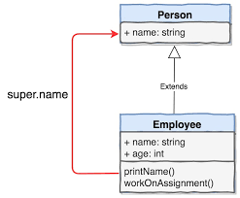
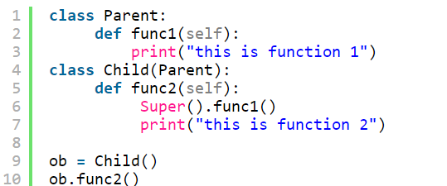
SUPER METHOD

Slide 29
WHAT IS THE OUTPUT
class A:
def __init__(self,x=3):
self._x = x
class B(A):
def __init__(self):
super().__init__(5)
def display(self):
print(self._x)
def main():
obj = B()
obj.display()
main()
a) 5
b) Error, class member x has two values
c) 3
d) Error, protected class member can’t be accessed in a subclass
a

Slide 30
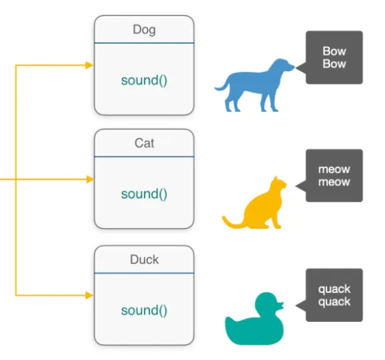
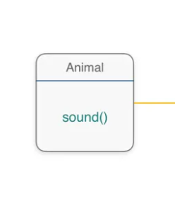
POLYMORPHISM

Slide 31
POLYMORPHISM
Polymorphism Means a Many-form, Its derived from 2 Greek words: First word “poly” means many and another “morphs” means forms.
Existence of one function in many forms
A Polymorphism possible when classes are related to each other by is-a Relationship (Inheritance).

Slide 32
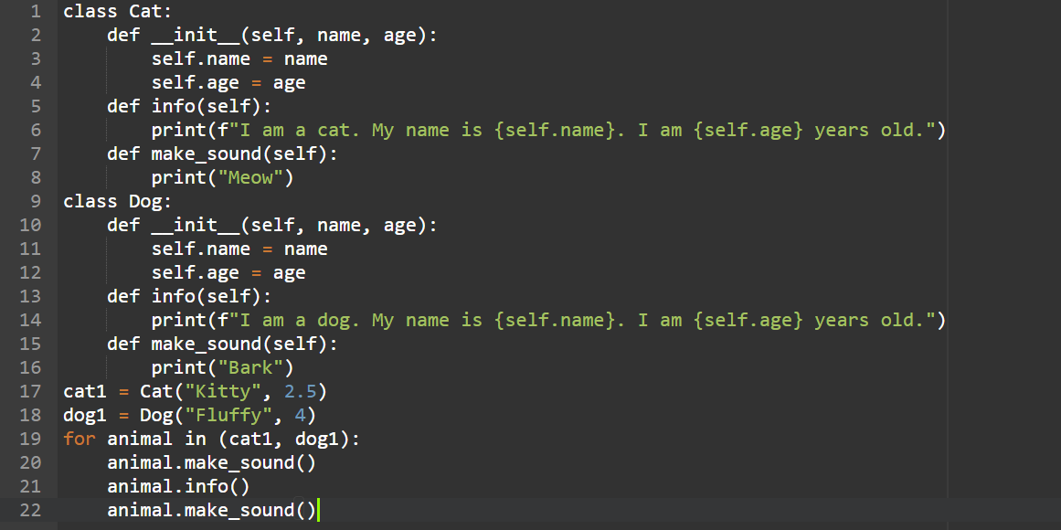
CODE ON POLYMORPHISM

Slide 33
METHOD OVERRIDING
Redefining certain methods and attributes specifically to fit the child class, which is known as Method Overriding.
Polymorphism allows us to access these overridden methods and attributes that have the same name as the parent class.

Slide 34
WHAT IS THE OUTPUT
What is the use of duck typing ?
a) More restriction on the type values that can be passed to a given method b) No restriction on the type values that can be passed to a given method c) Less restriction on the type values that can be passed to a given method d) Makes the program code smaller
c

Slide 35
WHAT IS THE OUTPUT
class A:
def __str__(self):
return '1'
class B(A):
def __init__(self):
super().__init__()
class C(B):
def __init__(self):
super().__init__()
def main():
obj1 = B()
obj2 = A()
obj3 = C()
print(obj1, obj2,obj3)
main()
a) 1 1 1
b) 1 2 3
c) ‘1’ ‘1’ ‘1’
d) An exception is thrown
a

Slide 36
WHAT IS THE OUTPUT
What will be the output of the following Python code?
class A:
def __init__(self, x, y):
self.x = x
self.y = y
def __str__(self):
return 1
def __eq__(self, other):
return self.x * self.y == other.x * other.y
obj1 = A(5, 2)
obj2 = A(2, 5)
print(obj1 == obj2)
a) False
b) 1
c) True
d) An exception is thrown
c

Slide 37
WHAT IS THE OUTPUT
Which of the following statements is true?
a) A non-private method in a superclass can be overridden b) A subclass method can be overridden by the superclass c) A private method in a superclass can be overridden d) Overriding isn’t possible in Python
a

Slide 38
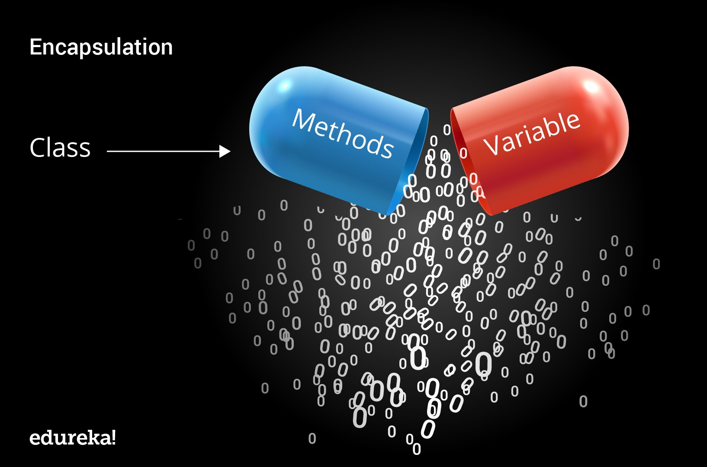
DATA ENCAPSULATION

Slide 39
ENCAPSULATION
Encapsulation is a technique in which access to methods and class are restricted.
we denote private attribute using underscore as prefix i.e single “ _ “ or double “ __“.
‘_’ – single underscore is meant for protected mode.
Encapsulation wraps the implementation of class is hidden and only restricted usage is allowed

Slide 40
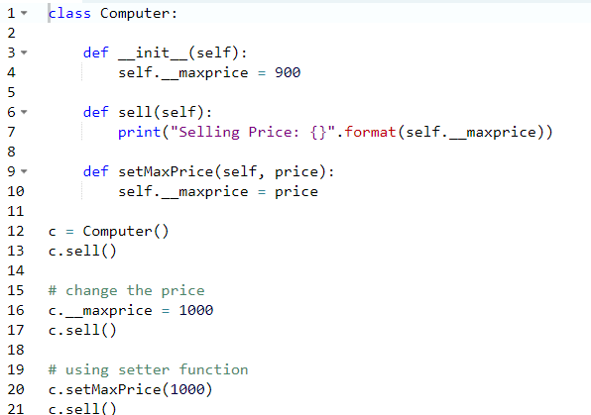
CODE ON ENCAPSULATION

Slide 41
WHAT IS THE OUTPUT
Which of the following is the most suitable definition for encapsulation?
a) Ability of a class to derive members of another class as a part of its own definition b) Means of bundling instance variables and methods in order to restrict access to certain class members c) Focuses on variables and passing of variables to functions d) Allows for implementation of elegant software that is well designed and easily modified
b

Slide 42
WHAT IS THE OUTPUT
What will be the output of the following Python code?
class Demo:
def __init__(self):
self.a = 1
self.__b = 1
def display(self):
return self.__b
obj = Demo()
print(obj.__b)
a) The program has an error because there isn’t any function to return self.a
b) The program has an error because b is private and display(self) is returning a private member
c) The program has an error because b is private and hence can’t be printed
d) The program runs fine and 1 is printed
c

Slide 43
WHAT IS THE OUTPUT
Methods of a class that provide access to private members of the class are called as ______ and ______
a) getters/setters b) __repr__/__str__ c) user-defined functions/in-built functions d) __init__/__del__
a

Slide 44
WHAT IS THE OUTPUT
Private members of a class cannot be accessed.
a) True b) False
b

Slide 45
WHAT IS THE OUTPUT
What will be the output of the following Python code?
class objects:
def __init__(self):
self.colour = None
self._shape = "Circle"
def display(self, s):
self._shape = s
obj=objects()
print(obj._objects_shape)
a) The program runs fine because name mangling has been properly implemented
b) Error because the member shape is a protected member
c) Error because the proper syntax for name mangling hasn’t been implemented
d) Error because the member shape is a private member
b

Slide 46
DATA ABSTRACTION
Data abstraction is a programming (and design) technique that relies on the separation of interface and implementation.
Data abstraction refers to providing only essential information to the outside world and hiding their background details, i.e., to represent the needed information in program without presenting the details.
Abstraction means hiding the complexity and only showing the essential features of the object.
An abstract class can have both a normal method and an abstract method
An abstract class cannot be instantiated, ie., we cannot create objects for the abstract class

Slide 47
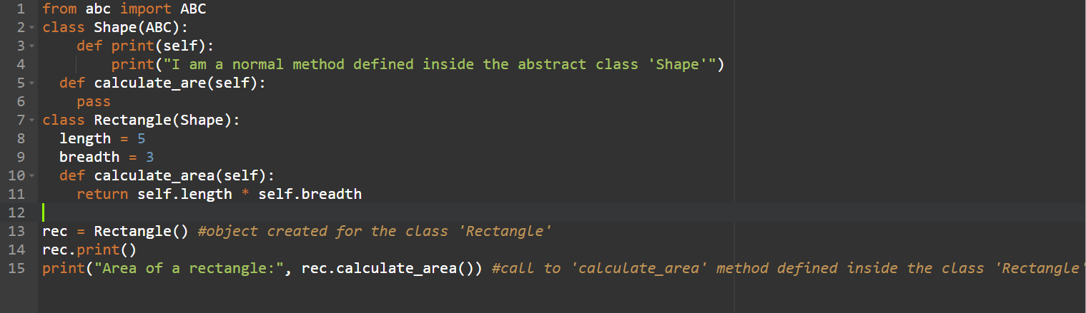
CODE FOR DATA ABSTRACTION

Slide 48

EXCEPTION HANDLING
Why
Exception??
Exceptions are convenient in many ways for handling errors and special conditions in a program. you have a code which can produce an error then you can use exception handling.

Slide 49
RAISING AN EXCEPTION
Raising an exception breaks current code execution and returns the exception back until it is handled.
You can raise an exception in your own program by using the raise exception statement.

Slide 50
EXCEPTION ERRORS
IO ERROR
If the file cannot be opened
IMPORT ERROR
If python cannot find the module
VALUE ERROR
Raised when a bult-in operation or function receives an argument that has the right type but an appropriate value
KEYBOARD INTERRUPT
Raised when the user hits the interrupt key
EOF ERROR
Raised when one of built-in functions hits an end-of-file condition(EOF) without reading any data

Slide 51
EXCEPTION ERRORS
To use exception handling in Python, you first need to have a catch-all except clause.
The words "try" and "except" are Python keywords and are used to catch exceptions.
try-except [exception-name] (see above for examples) blocks
The code within the try clause will be executed statement by statement.
If an exception occurs, the rest of the try block will be skipped and the
Except clause will be executed.

Slide 52
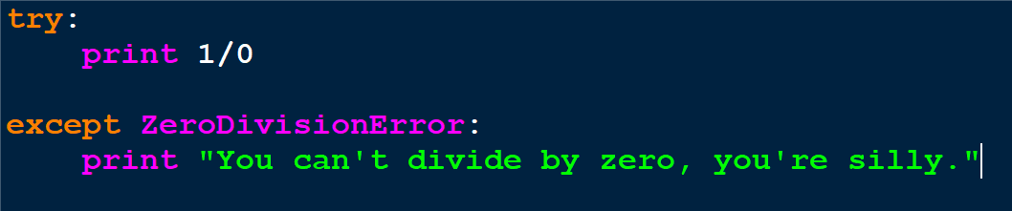
SAMPLE PROGRAM ON EXCEPTION
The error handling is done through the use of exceptions that are caught in try blocks and handled in except blocks.
If an error is encountered, a try block code execution is stopped and transferred down to the except block. In addition to using an except block after the try block, you can also use the finally block.
The code in the finally block will be executed regardless of whether an exception occurs.

Slide 53
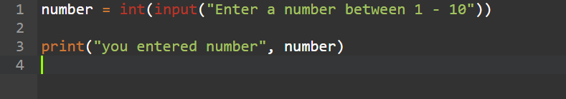
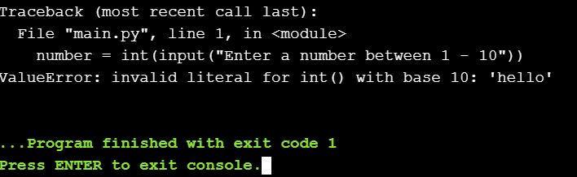
WITHOUT EXCEPTION HANDLING
ValueError is an exception type. Let's see how we can use exception handling to fix the previous program

Slide 54
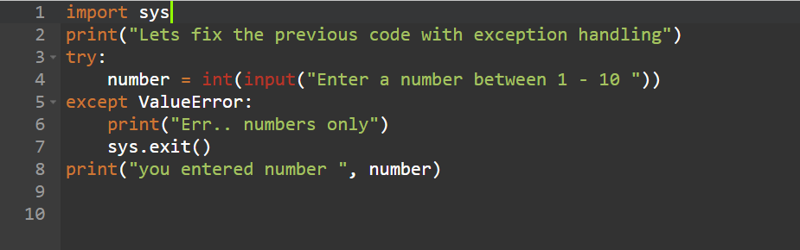
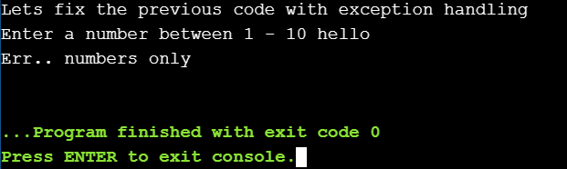
WITH EXCEPTION HANDLING
Now the error which is raised is handled by exception block

Slide 55
WHAT IS THE OUTPUT
When will the else part of try-except-else be executed?
a) always b) when an exception occurs c) when no exception occurs d) when an exception occurs in to except block
c

Slide 56
WHAT IS THE OUTPUT
Is the following Python code valid?
try:
# Do something
except:
# Do something
finally:
# Do something
a) no, there is no such thing as finally
b) no, finally cannot be used with except
c) no, finally must come before except
d) yes
b

Slide 57
WHAT IS THE OUTPUT
Can one block of except statements handle multiple exception?
a) yes, like except TypeError, SyntaxError [,…] b) yes, like except [TypeError, SyntaxError] c) no d) none of the mentioned
a

Slide 58
WHAT IS THE OUTPUT
What will be the output of the following Python code?
try:
if '1' != 1:
raise "someError"
else:
print("someError has not occurred")
except "someError":
print ("someError has occurred")
a) someError has occurred
b) someError has not occurred
c) invalid code
d) none of the mentioned
c

Slide 59
WHAT IS THE OUTPUT
What will be the output of the following Python code?
def a():
try:
f(x, 4)
finally:
print('after f')
print('after f?’)
a()
a) No output
b) after f?
c) error
d) after f
c

Slide 60
SUMMARY
OOPS AND ITS CONCEPTS

Slide 61

PRACTICE CODING

Slide 62

ANY QUERIES?

Slide 63


POST TRAINING - DOUBTS
OR
Scan this QR code and say “Hi”

Slide 64

KEEP WAITING FOR NEXT SESSION

Slide 65
THANK YOU

